Slide 1


Sarvajanik College of Engineering and Technology
Computer Networks (2140709)
Study of Network Simulator: NS2
Submitted to:
Prof.(Dr.) Pariza Kamboj
Prof. Krishna Dalasaniya
Prepared By:
Agarwal Muskan - 160420107001
Akbari Darshit - 160420107002
Amul Luniya - 160420107003
Bhagwakar Priya - 160420107004
Bhatia Sagar - 160420107005

Slide 2
Index
  What is simulator?
  What is NS2 simulator?
  Architecture of NS2
  Components of NS2
  NS2 Installation
  Functionality Of NS2
  TCL Script Steps to:
    Creating Topology
    Links
    Traffic generators

Slide 3
What is a Network Simulator?
A network simulator is software that predicts the behavior of a computer network. Since communication Networks have become too complex for traditional analytical methods to provide an accurate understanding of system behavior, network simulators are used. In simulators, the computer network is modeled with devices, links, applications etc. and the performance is analyzed.

Slide 4
NS2…
NS2 is a discrete event network simulator for wired and wireless networks alike.
It is popular for its extensibility (due to its open source model).
Supports an array of popular network protocols
Popularly used in the simulation of routing and multicast protocols, and is heavily used in ad-hoc research.
NS2 is written in C++ and OTcl.
OTcl = Tcl + OO (Object Oriented)
C++ implements the code that is executed frequently.
OTcl configures the system.

Slide 5
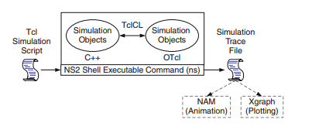
Architecture of NS2
Notes:
Source code of OTcL is written in C++. The OTcL Llibrary consists of several functions which can be modified and added within the source code.
NAM shows the animations of the packets traveling from one node in a computer network topology to another node. The Xgraph is another program which graphically depicts the packter transfers.

Slide 6
Components of NS2
NS, the simulator itself
nam, the Network Animator
  visualize NS (or other) output
  GUI input simple NS scenarios
  Supports topology layout, packet level animation and various data inspection tools
Pre-processing:
  traffic and topology generators
Post-processing:
  simple trace analysis, often in Awk, Perl or Tcl
Notes:
Awk, Perl, Tcl are high level languages in which the simulation code to be executed is written. The network is simulated and set up in this code.

Slide 7
NS2 Installation
Download NS-allinone-2.34 package
  http://www.isi.edu/nsnam/ns/
  for easy installation, download ns-allinone
  includes Tcl, Otcl, TclCL, ns, nam, etc.
Works on Unix and cygwin for windows 9x/2000/xp.
After successful downloading and unzipping install all-in-one package, install NS by
  install by calling ~/ns-allinone-2.34/install
After successful installation , Validate the scripts by running ./validate in ~/ns-allinone-2.34/ns-2.34/
Its now all set to work with NS

Slide 8
Functionality Of NS2
Traffic models and applications
  Web, FTP, Telnet, CBR, real time traffic
Transport protocols
  Unicast: TCP (Reno, New-Reno, Vegas, etc.), UDP
  Multicast: SRM
Routing and queuing
  Wired and ad-hoc routing and directed diffusion
  Queuing protocols: RED, drop-tail, etc
Physical media
  Wired (point-to-point, LANs), wireless (multiple propagation models), error models, satellite
Notes:
CBR – constant bit rate – quality of service
Telnet – a protocol that allows you to connect to remote computers(hosts) over a TCP/IP network.

Slide 9
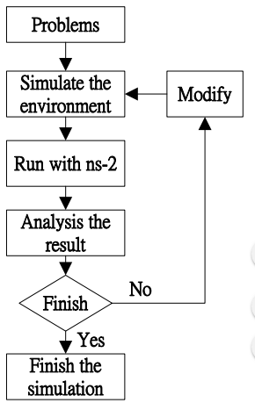
Functional Diagram of NS2

Slide 10
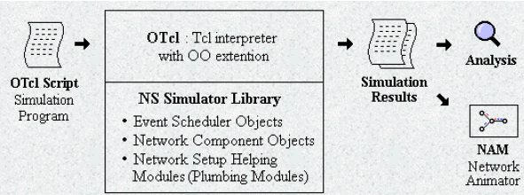
Simplified User’s View of NS-2

Slide 11
Data and Control Separation
TCL in the Front End
- Control part of NS2
- Topology (Simulation scenario) configurations
- Event driven
• Periodic or Triggered action
- Manipulates existing C++ objects
- Easy to write and edit
C++ in the Back End
- Core of NS2, data part of NS2
- Easy to modify the code
Not fully layered and structured
- Packet processing and execution

Slide 12
Generic Script Structure
set ns [new Simulator]
# [Turn on tracing]
# Create topology
# Setup packet loss, link dynamics
# Create routing agents
# Create:
# - multicast groups
# - protocol agents
# - application and/or setup traffic sources
# Post-processing procs
# Start simulation

Slide 13
Creating Topology
Decide what do you want to simulate
- Wired or wireless network
- What are the protocols?
- How many nodes, what are the measuring
parameters?
- What are the applications involved, etc?
Make a rough sketch of the topology
- Figure out the concerned files (C++ or .tcl)
- Based on the requirement do the following
• Edit the existing C++ files and/or the .tcl files.
• You can create new C++ files.

Slide 14

Creating Network
Nodes
  set n0 [$ns node]
  set n1 [$ns node]
n1

Slide 15

Creating Network
Links and queuing
$ns duplex-link $n0 $n1 <bandwidth>
<delay> <queue_type>
<bandwidth>: 1000b, 1kb, 0.001Mb, …
<delay>: 1ms, 0.001s, …
<queue_type>: DropTail, RED, CBQ, FQ, SFQ, DRR.
n1

Slide 16
Creating Connection – Agents
UDP
  set src [new Agent/UDP]
  set rcv [new Agent/Null]
  $ns connect $src $rcv
TCP
  set tcp [new Agent/TCP]
  set tcpsink [new Agent/TCPSink]
  $ns connect $tcp $tcpsink

Slide 17
Creating Traffic – Applications
Use app on Top of agent:
$app start
$app stop
FTP
set ftp [new Application/FTP]
$ftp attach-agent $tcp
Telnet
set telnet [new Application/Telnet]
Web
set session [new httpSession $ns <numPages>
<clientNode>]
Traffic generator
set cbr [new Application/traffic/cbr]

Slide 18
Computing Routes
Unicast
-$ns rtproto <type>
- <type>: Static, Session, DV, cost, multipath
Multicast
-Simulator set EnableMcast_ 1
-Simulator set NumberInterfaces_ 1
-$ns mrtproto <type>
-<type>: CtrMcast, DM, dynamicDM,pimDM

Slide 19

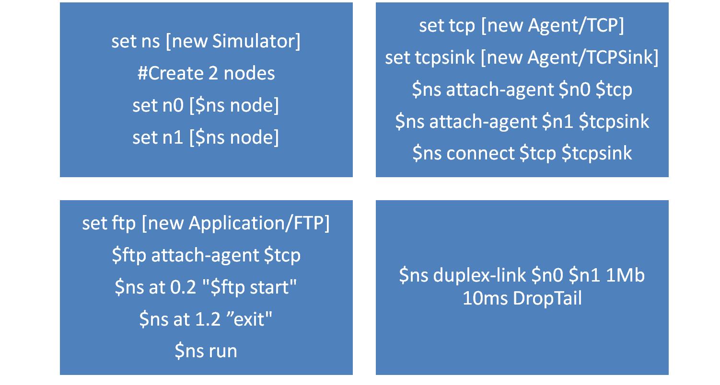
Example 1: TCP (FTP from n0 to n1)

Slide 20
References
https://www.slideshare.net/
https://www.isi.edu/nsnam/ns/tutorial/nsscript1.html
https://en.wikipedia.org/wiki/Network_simulation

Slide 21


